Slide 1
Task 1

Slide 2
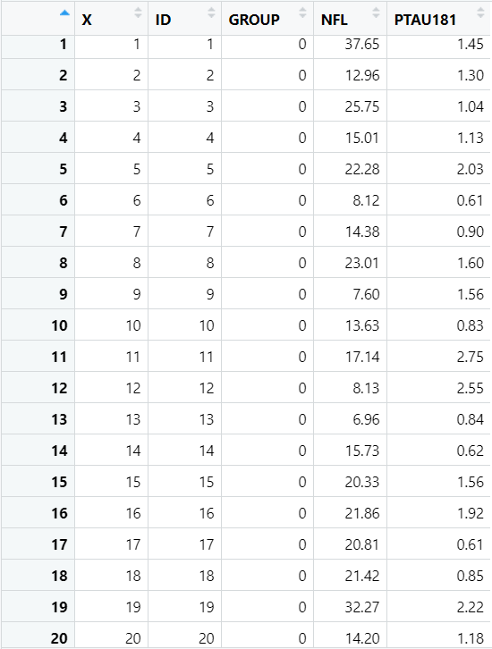
Data of Control

Slide 3
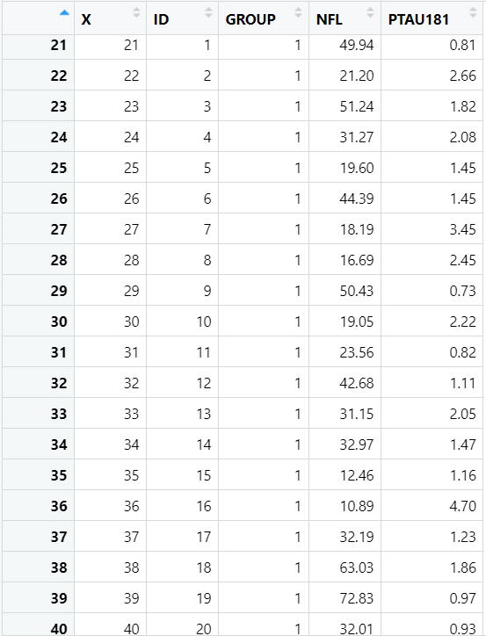
Data of Group 1 (Alzheimer Group)

Slide 4
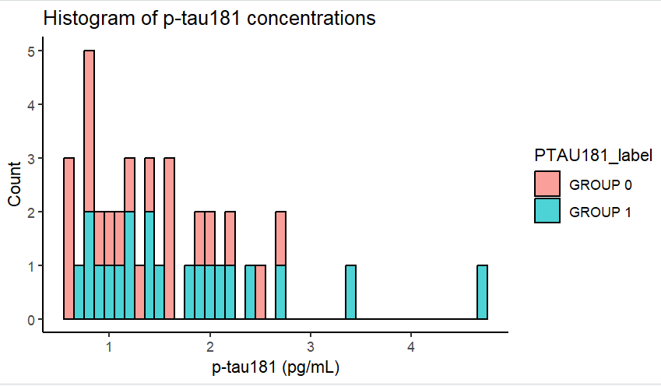
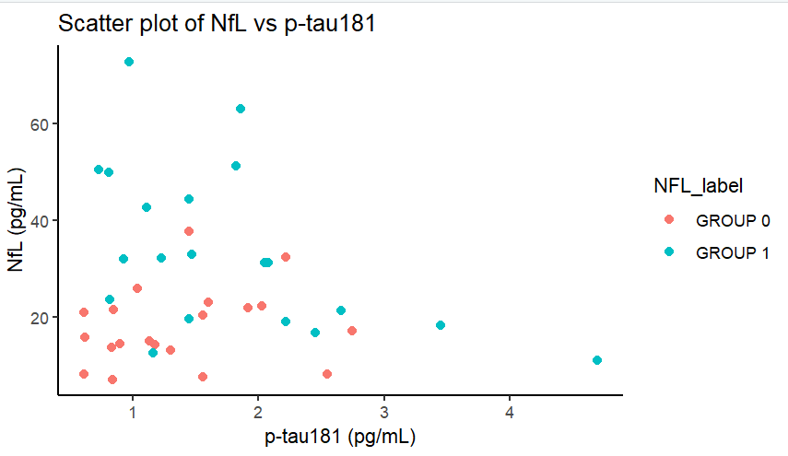
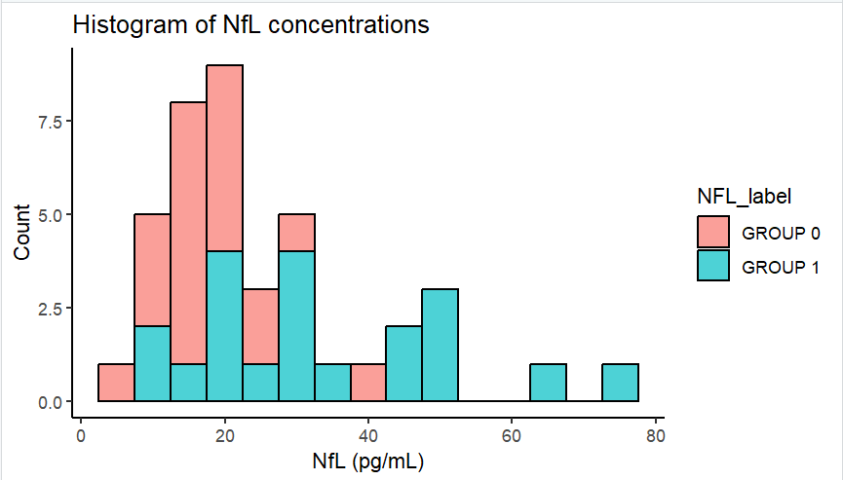
Visual representation

Slide 5
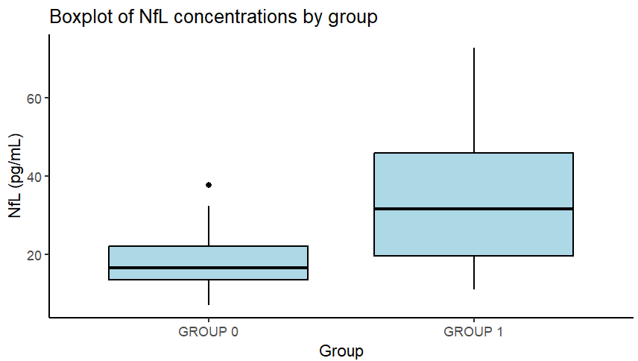
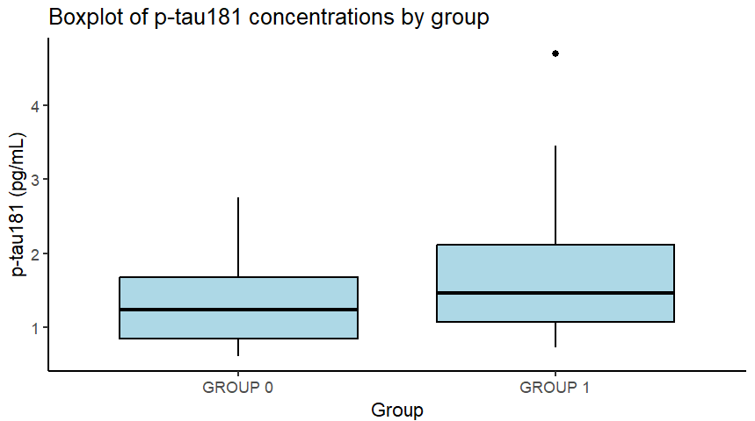
Box plots

Slide 6
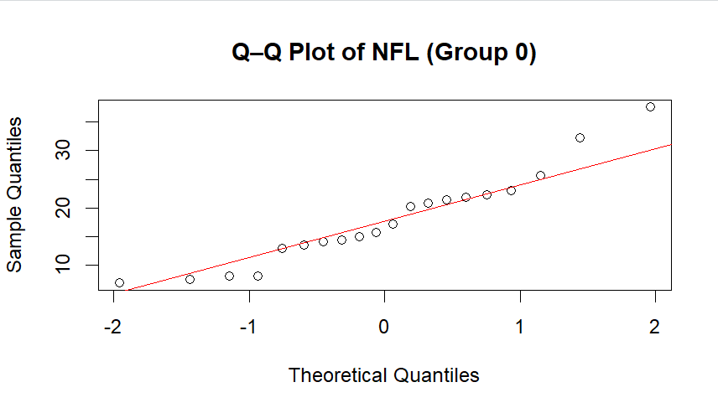
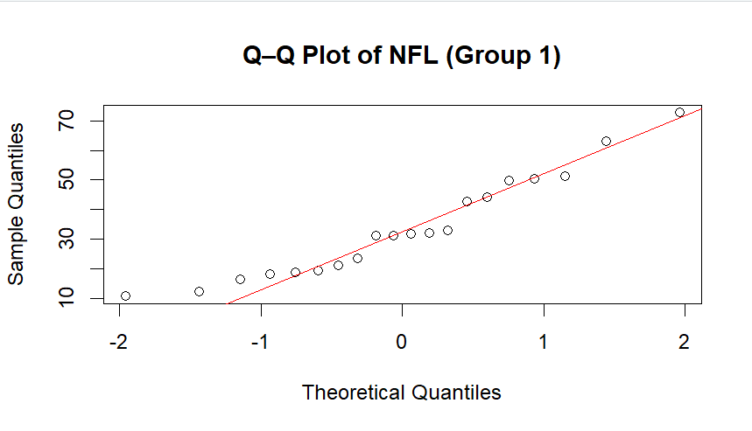
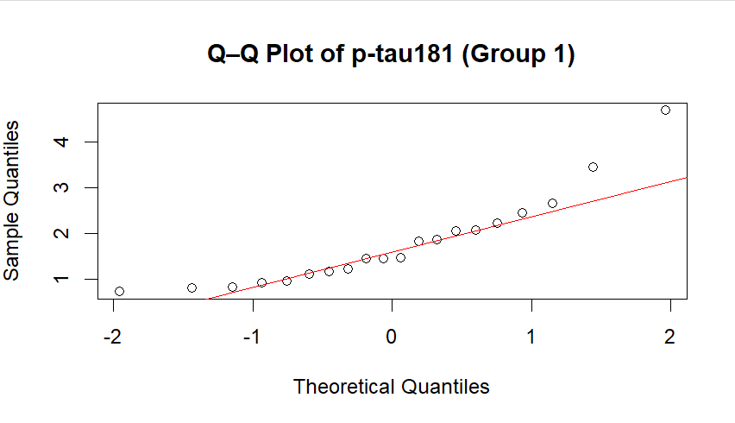
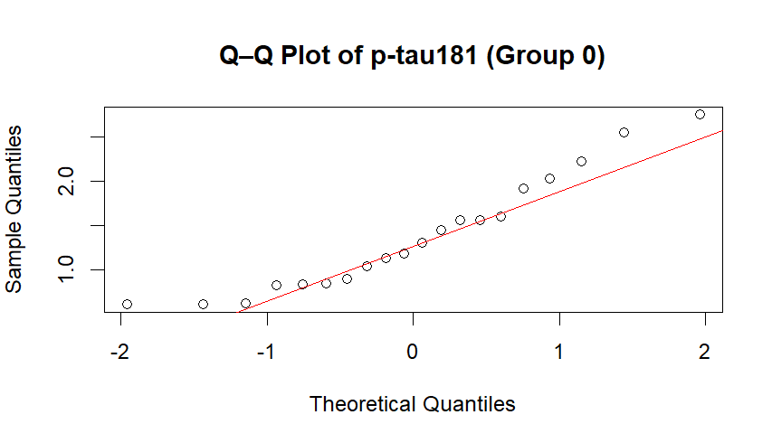
QQ-plots

Slide 7
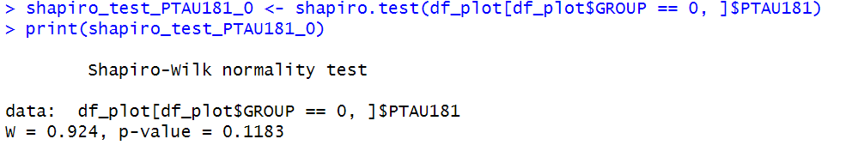
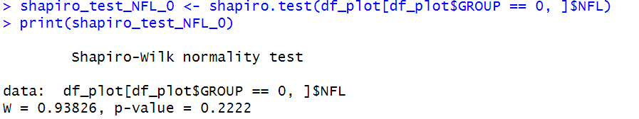
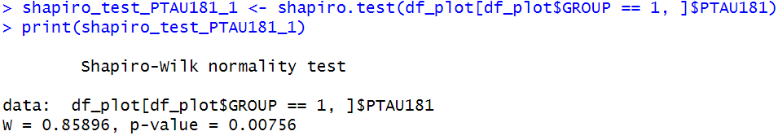
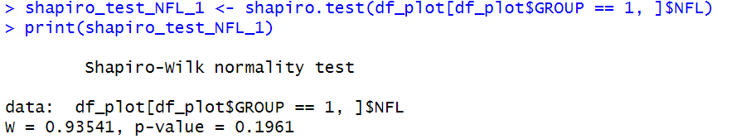
Shaprio test
PTAU181 (Group 0)
NFL (Group 0)
PTAU181 (Group 1)
NFL (Group 1)

Slide 8
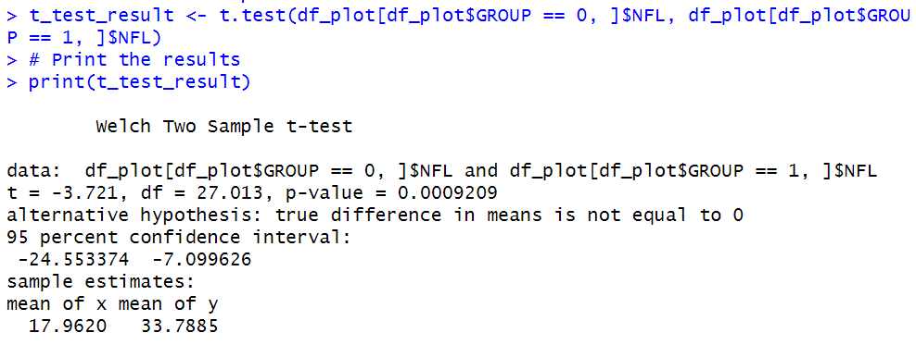
T-test with NFL

Slide 9
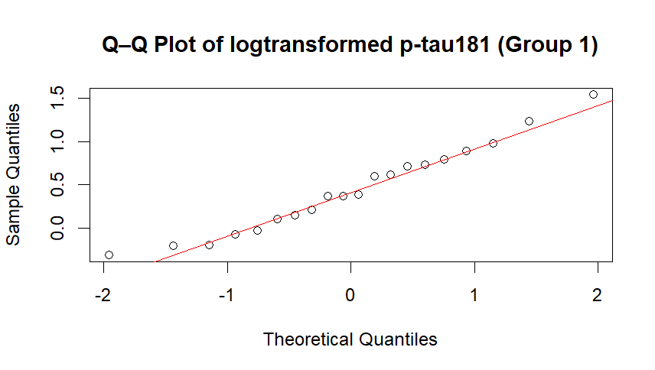
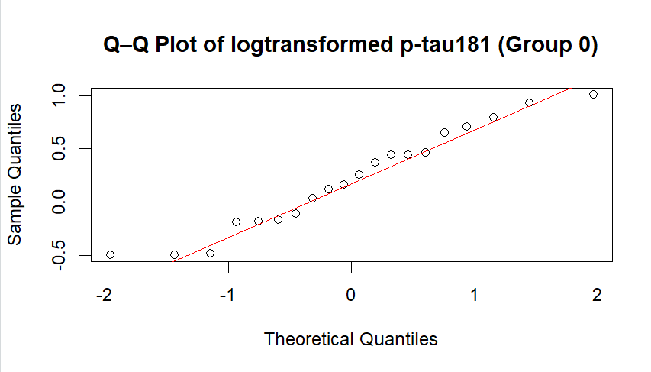
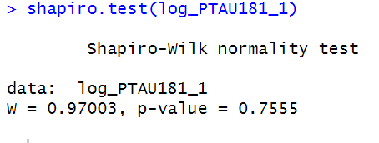
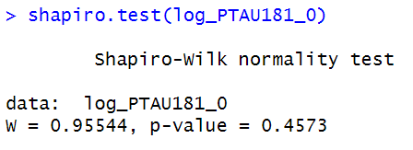
Logtransform p-tau181 data

Slide 10
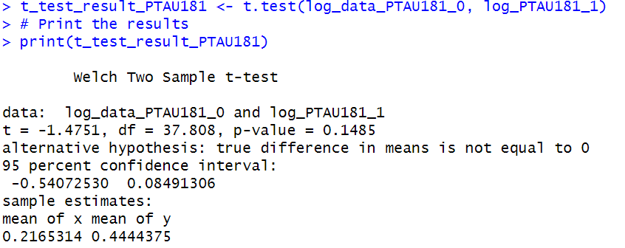
T-test of log-distribution

Slide 11
Summary
NFL data is normally distributed: we can use t-test on data
The difference between the control group and the AD group was signiflicantly different.
P-tau181 data for AD group was not normally distributed.
The difference between the control group and the AD group was not signiflicantly different.

Slide 12
Approach
T-test:
Pros: Powerful, examines the numerical data, mean
Cons: assumes normality, outliers affect (with low sample size)
Willcoxon rank sum test:
Pros: No normality assumption, robust to outliers
Cons: Less powerful than t-test, test median not mean
Logtransform
Brigs right skewed data more to normally distirubted data.
Our statistical approach combined visual exploration, normality testing, and hypothesis testing tailored to each biomarker’s distribution

